Slide 1


CS2113/T – Lecture 10
Join the session: http://pollev.com/anarayan
Archipelago session:
This lecture will be recorded
This lecture will be recorded
Disclaimer: There is a question towards the end of the lecture today

Slide 2

Recap
Design patterns
Sequence diagrams
– interactions between different entities
Test coverage

Slide 3
Q Using design patterns can potentially make your code slow.
True (true)
False

Slide 4
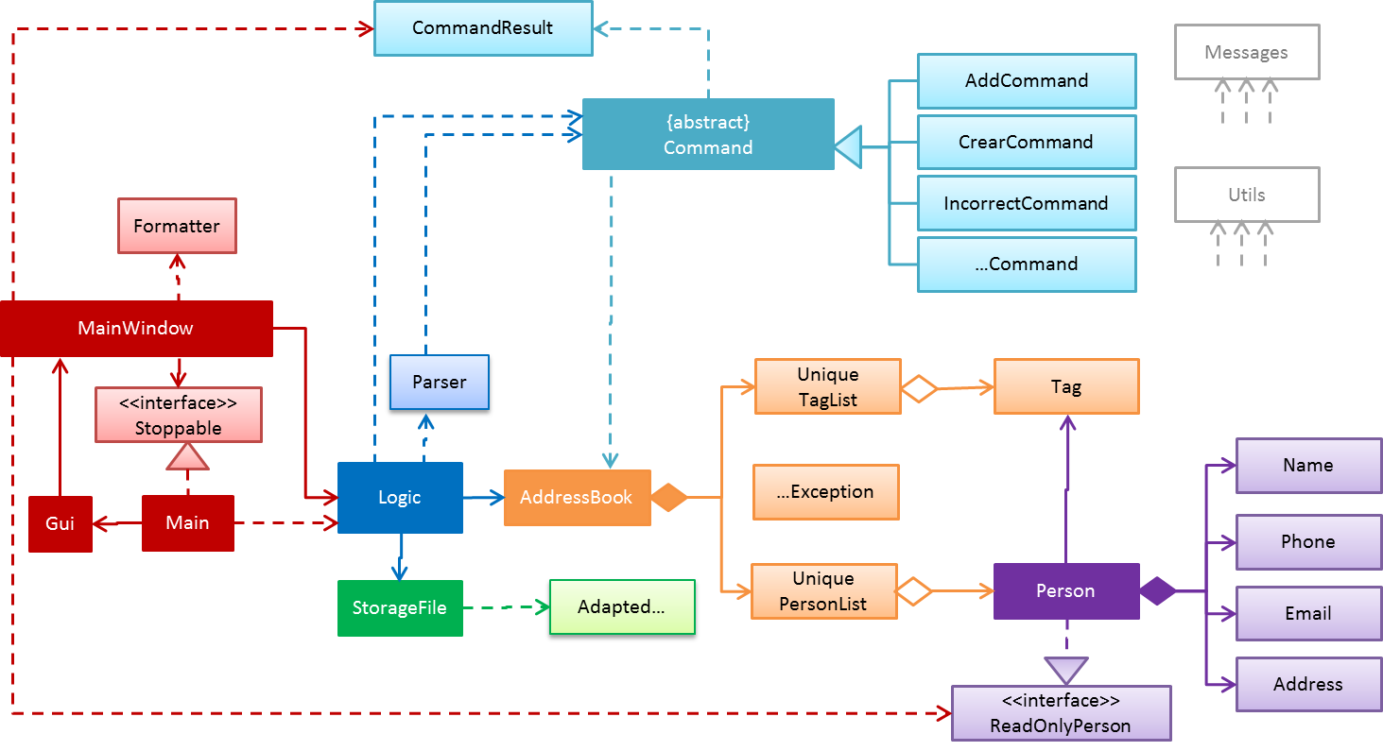
Notes:
A proper class diagram looks like this. Can understand the entire design by looking at the class diagram

Slide 5
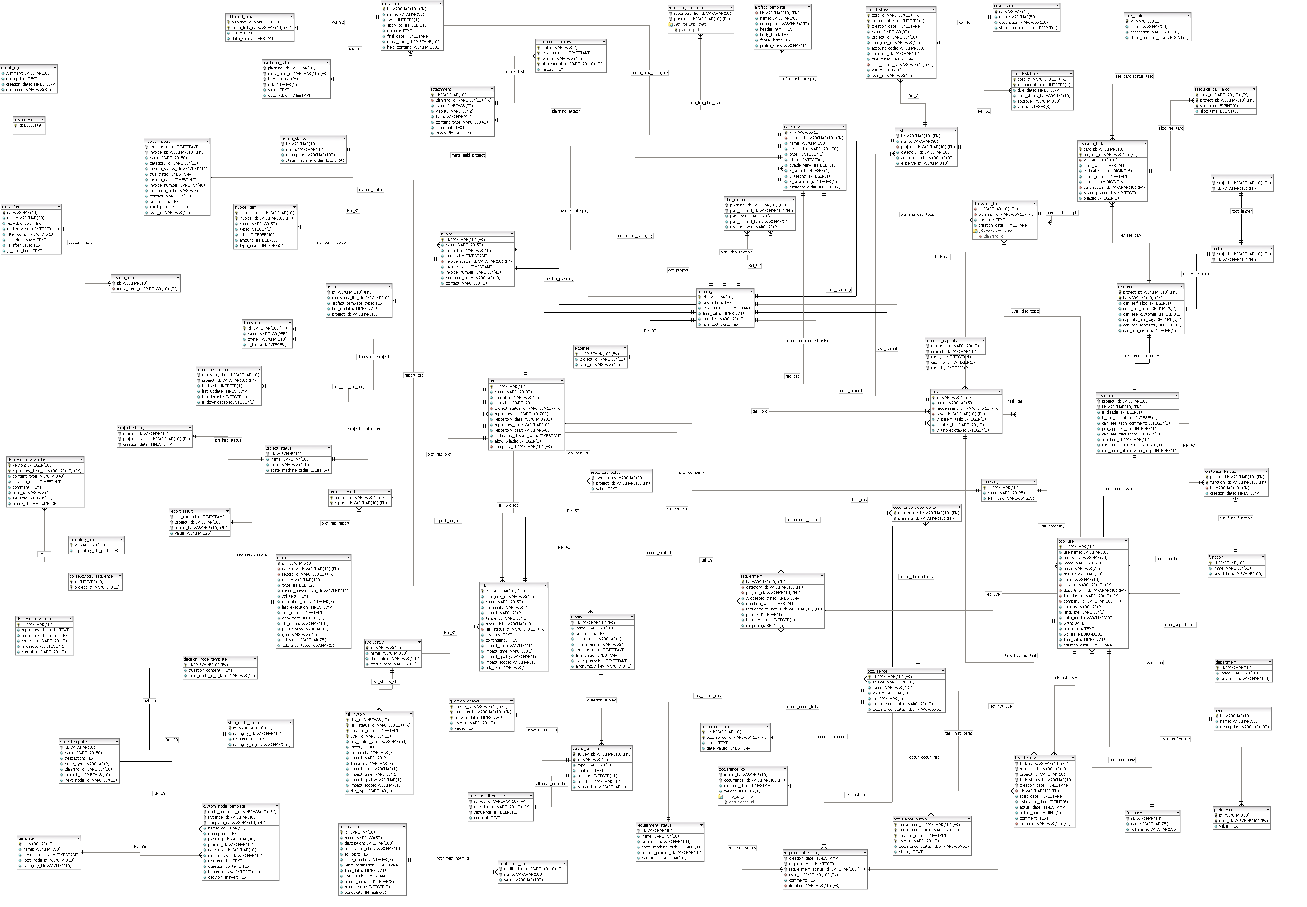

Slide 6
Know in depth
Have good idea
Notes:
Your system is a bunch of interacting components; you know what you are developing very well.
You have idea of what is happening in the rest of the system

Slide 7
Architecture
+ (important technical decisions)
Notes:
One way to understand the entire project is via architecture.
Captures the overall organization of the system and is a high level design
Important – cli/gui? Local/ webapp? Single/multi-user

Slide 8
Architecture
+ (important technical decisions)

Slide 9
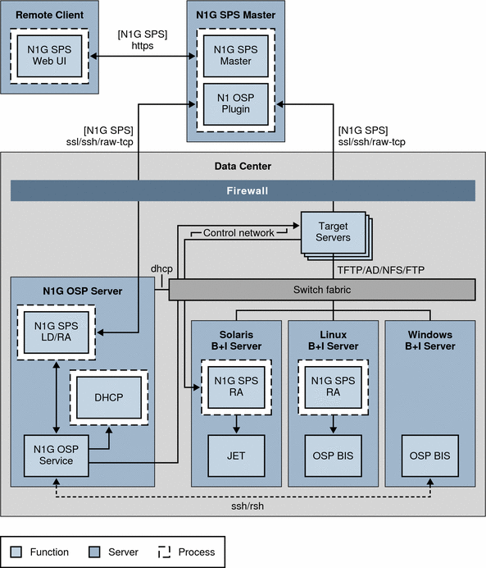
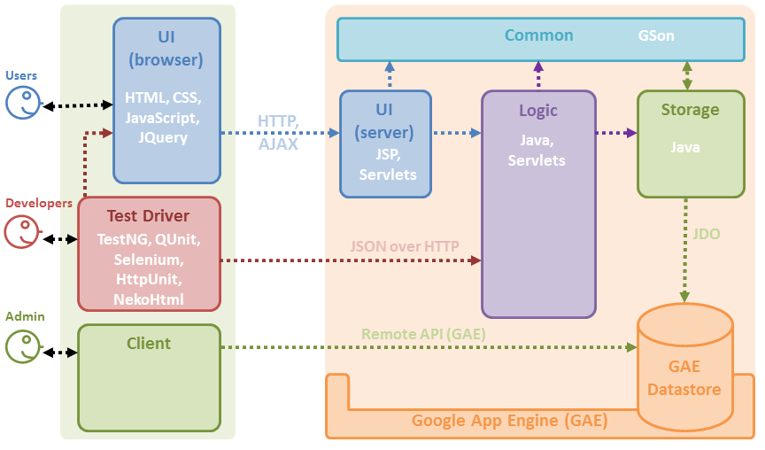
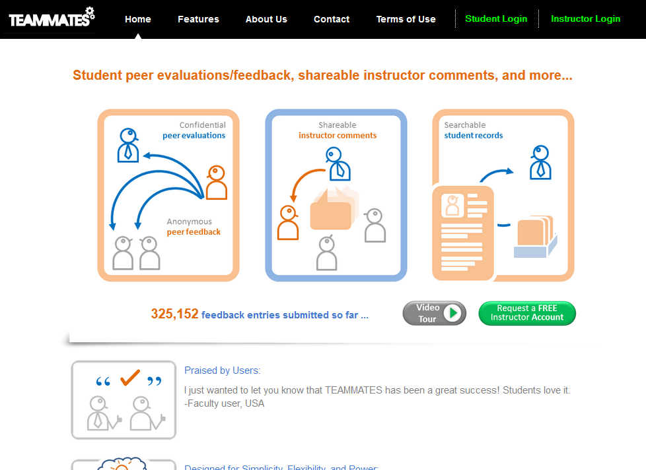
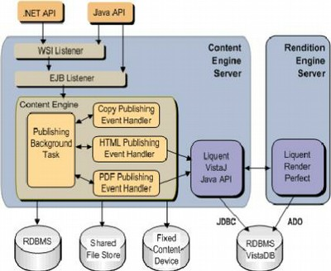
TEAMMATES

Slide 10
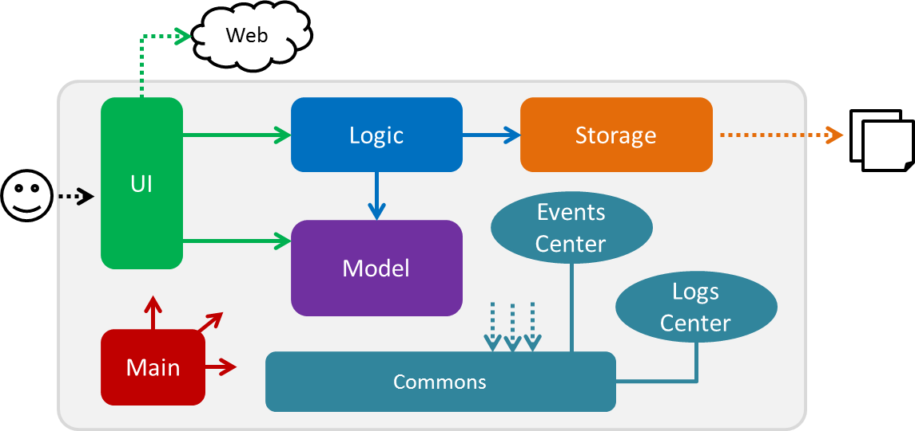
Address Book Level 4 (200+ classes, 10 KLoC)

Slide 11
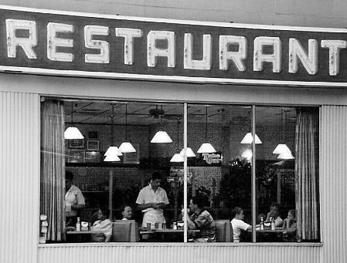
Procedural
Boil water
Put tea leaves in strainer
Add hot water
Steep for a while
Remove strainer
Add milk and sugar
Designing OOP software needs OOP thinking
OOP
1 chef
2 waiters
1 cashier
1 part time accountant
1 manager
1 cash register
1 stove
Serve tea
Clean table
Toast bread
Cut bread
Accept payment
Give change
Issue receipt
Wash utensils
Pay bills
Order supplies
…… … …
Notes:
You should have realized by now that to develop an oo software, you need to think in OO way. You cannot think in lower level data structure and operations and think that I will build on top of this and come up with an OO solution magically

Slide 12
OOP
Architecture
1 chef
2 waiters
1 cashier
1 part time accountant
1 manager
1 cash register
1 stove
Divisions/Departments
Kitchen
Accounting
Customer Services
Purchasing
Notes:
Architecture - Looking at the problem at a much higher level of abstraction

Slide 13
OOP
Architecture

Slide 14
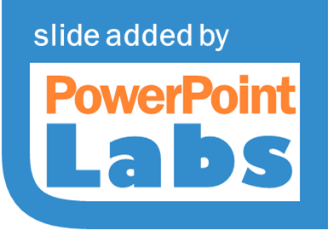
OOP
Architecture

Slide 15

Architecture
A
B
D
Achievement Unlocked! Multi-level design
C
:A
:B
:D
Different levels of abstraction
OOP Component design
Component A design
Component C design
A
C
*
B
*
D
C
Component B design
Component D design
Notes:
Mental hurdle: design top down, design at multiple levels

Slide 16
Architecture
How to break up into components?
Not done randomly!
+ (important technical decisions)
Who decides?
Software Architect
Notes:
Breaking up of code is not random

Slide 17
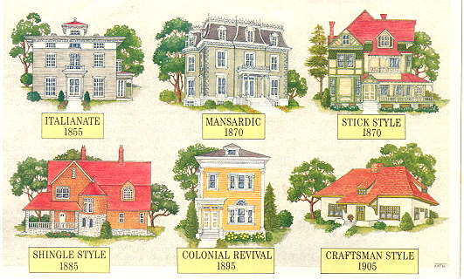
Architecture
styles

Slide 18
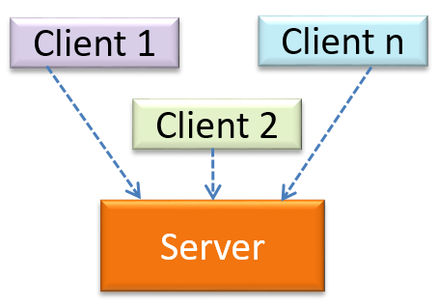
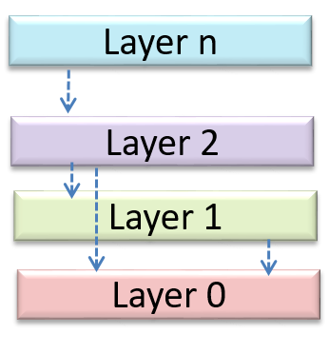
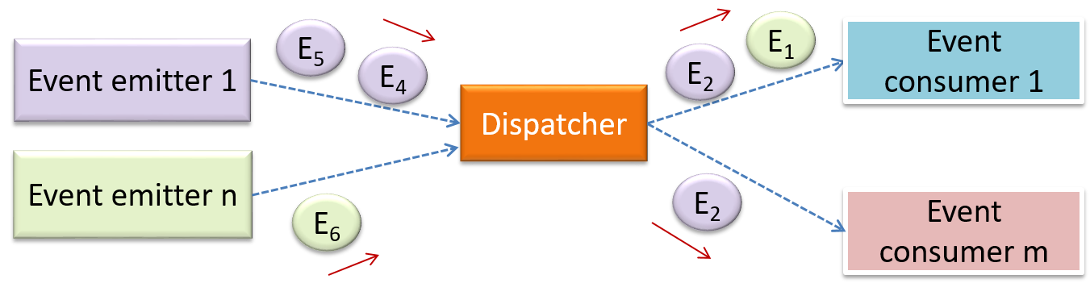
Architecture
styles
n-tier
Client-server
Event-driven
Notes:
N-tier: Component at higher level takes service from low level component, not other way round Eg., OS, many desktop applications, network applications
C-S: one entity is a server; provides the data to the requesters which are clients. E.g., websearch, doc servers, print servers etc.,
Event-driven: e.g., UI programming. One entity performs some action, other entity is interested in. but there is no direct connections. The performer will create events. E.g., button click, the consumer e.g., code that handles the button subscribes to the events. Dispatcher is responsible for coordination b/w producer and consumer.

Slide 19
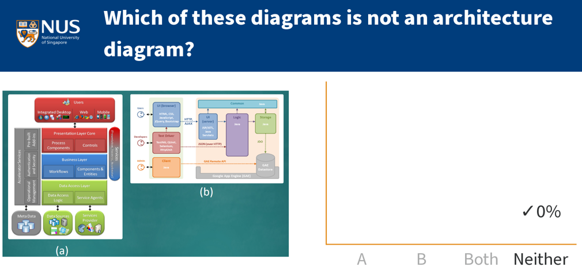

Slide 20
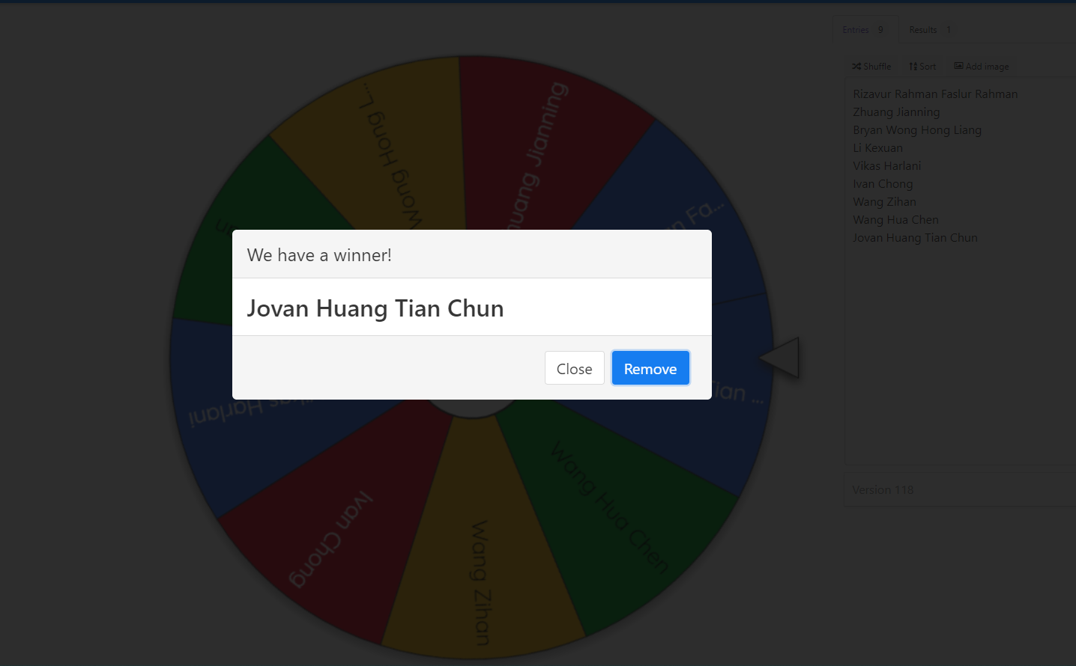
Spin the wheel!
Notes:
Zhu Zikun
Sim Bowen
Lok Ke Wen - past winners

